Slide 1



2 – About R & RStudio
they’re the same, right?
…right??
Notes:
So you definitely noticed that we had you install TWO DIFFERENT PROGRAMS with very similar names: R and RStudio.
So I wanted to take a moment to unpack what the difference is, because it’s understandably confusing if you’re getting started.

Slide 2
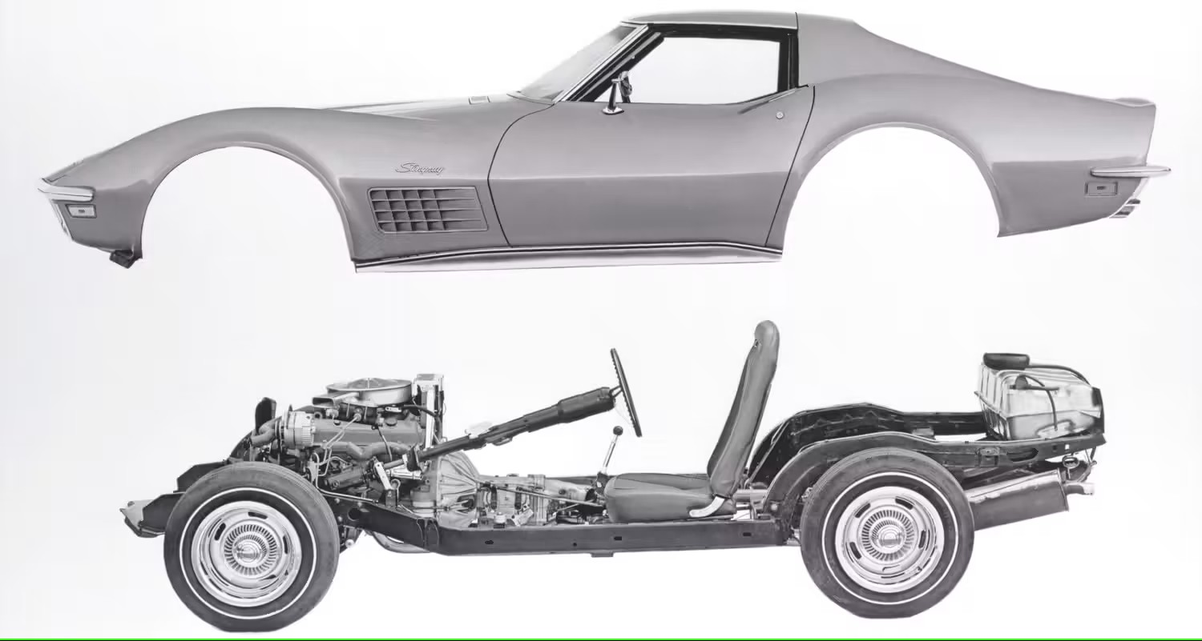


R vs RStudio
What is the difference between R and RStudio?
RStudio requires R to run in the background
If R is the engine, RStudio is the rest of the car
Side note: the Software Center might call R the “R Project”; avoid calling it that.
We’ll be using RStudio Projects (sometimes called R Projects) which is a very different concept
…but why??
Notes:
R is the language itself and the engine; RStudio is a full-featured program that RUNS R.
RStudio is what is called an Integrated Development Environment (or IDE) which makes running R a bit easier. Fwiw, there are other IDE’s that run R
If R is the engine, then RStudio is the rest of the car
--
You can use R by itself if you want, but … I’m not sure why you’d want to.
Side note: actually there are reasons – RStudio uses a bit more computational resources, so if you want to use EVERY LAST BIT OF RAM for your analysis….
--
As a side note, I don’t think this is an issue anymore, BUT…

Slide 3

To Open R
Going forward, when we say “Open R”, this will mean RStudio
Open this
Not this
R 4.4.3
RStudio
From now on, open RStudio
Easiest to double click the .Rproj file
Notes:
So one more time, this is the icon you want
--
Not this one.
--
And we’ll try to be explicit about referring to RStudio by name, but I’ll probably get lazy and say “R” when I mean RStudio
--
And we will be using RStudio Projects in this class (and we highly recommend them for you going forward), which I’ll talk about in a minute
A nice little trick is to double click the .Rproj file associated with your project to open RStudio

Slide 4
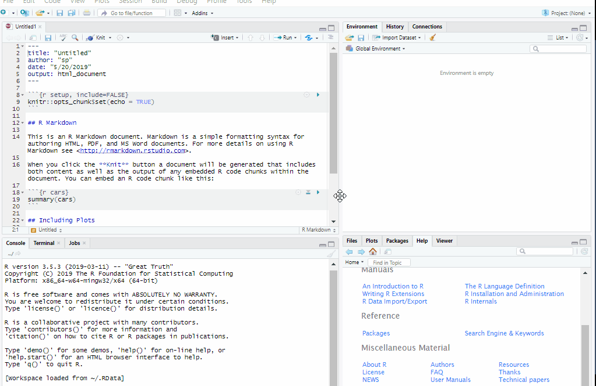
RStudio
You’ll see 4 panes. By default, they are:
Script editor in top left where you can write code before evaluating it,
Console in bottom left where code is evaluated and output is seen,
Environment in top right shows variables/dataframes (click on them to open and view!),
Plot/Help area in bottom right.
gif: https://www.pipinghotdata.com/posts/2020-09-07-introducing-the-rstudio-ide-and-r-markdown/
Notes:
We’ll jump into Rstudio in a minute, but here’s a slick little .gif, basically showing the default layout
You’ll see that it’s organized in four PANES (which will take the pain away)
(talk about these on the next slide]

Slide 5
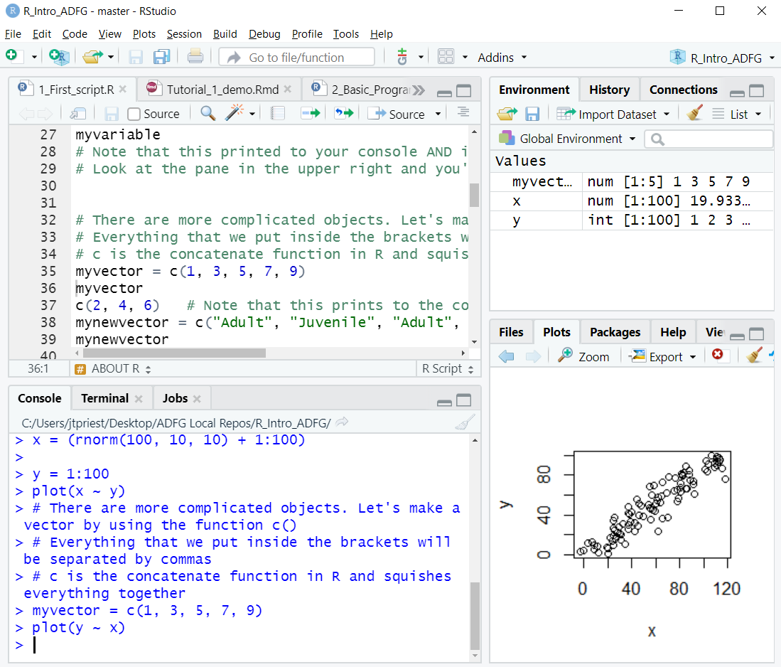
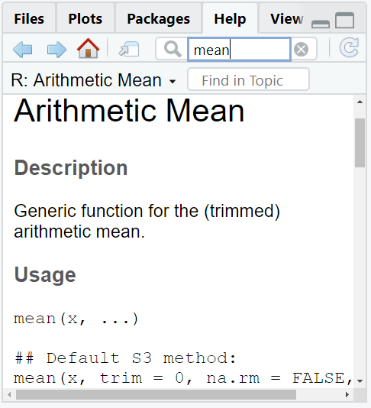
Script – A collection of lines of code saved to a file that can be run line by line, or all at once, usually the file extension is .R
If you want to save the code to use it again, you must save it in a script file
Script Editor
Environment
Environment – Shows all your variables. If it’s a dataframe, it’s clickable
Project – Shows which project you’re in. More on this later
Line – In script section each command has its own line. Lines must be complete bits of code otherwise they won’t evaluate (to wrap an incomplete chunk of code to the next line, it must end in a comma or something similar)
Plots / Help
Console
Plots – Shows your recent plots.
Help – Access the help file for every function
Console – The bottom part of the program where you can enter code to be run and where executed code is shown
5
Notes:
Here’s the default layout, and I want to briefly introduce the panes & tabs that you’re likely to use
And this slide is gross & cluttered, but I wanted to provide a printable reference if that turns out to be useful
The truth is, it will make much more sense once you start USING RStudio, and this is a part that you’ll probably pick up quickly.
--
The EDITOR pane is where you’ll see the scripts you have open. [CLICK]
A SCRIPT is just a sequence of instructions for R to run, which can be run line by line or all at once [CLICK]
Each LINE is a unique instruction for R
It’s worth noting that nothing “happens” here, this is just a sequence that has been saved
--
The CONSOLE is where things actually happen
Running a line of code dispatches it to the console, and that’s where you will see output if there is any
The script is the recipe book, the console is the oven??
--
The ENVIRONMENT shows things that have been created and are in R’s working memory.
It’s worth noting that these will go away when you close R!!!

Slide 6
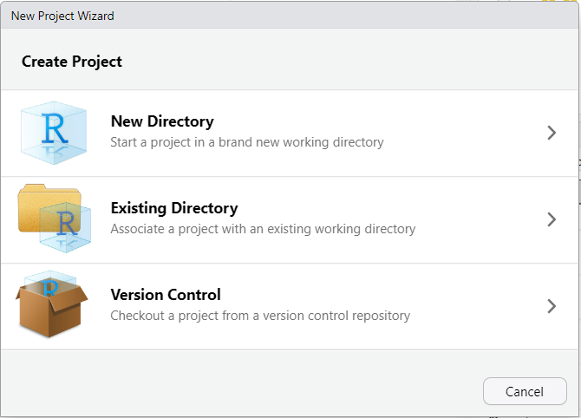
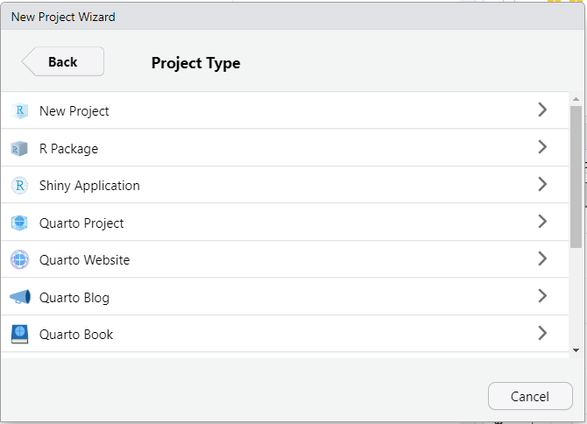
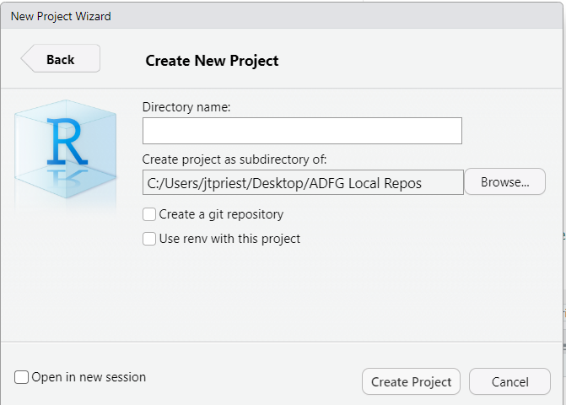

RStudio Projects
We highly recommend using RStudio projects
To create a new project:
Open RStudio. Click File -> New Project
New Directory (creates new folder you’ll move files to) or Existing Directory
Click New Project
Give descriptive name, choose where folder will be (can open in new window)
gmu13_blackbear_harvest
Notes:
We recommend using RStudio projects to organize your work.
We’ll actually walk through setting this up, but here’s a slide that gives a reference for how to create a new project if you need to refer back to it.

Slide 7
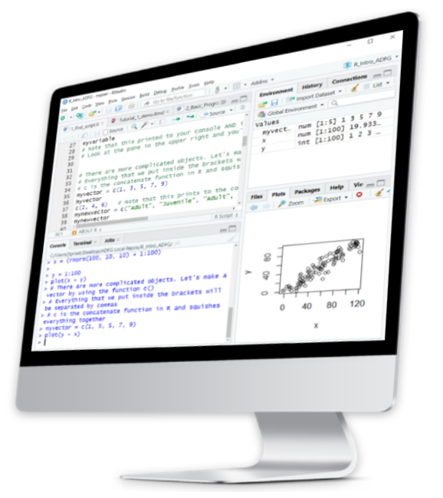
RStudio Demo
Let’s demo this in RStudio!
We’ll go over:
Unzipping folder we sent
How to start / open RStudio
What each “pane” is
Where to type your code
How to make a new RProject
Notes:
Ok! So let’s go over to RStudio and we’ll get everything set up and you can play around with all the panes!

Slide 8
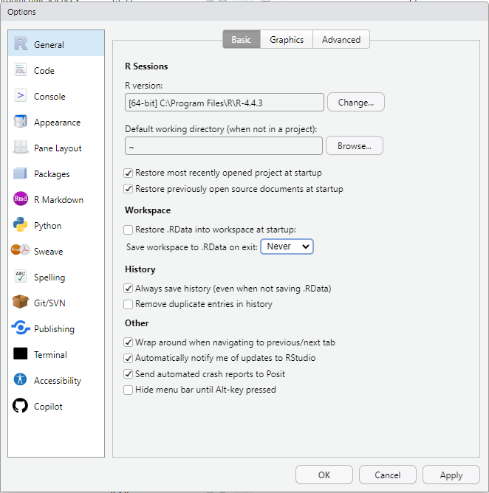
RStudio cont.
Highly recommended to change one default setting. Go to:
Tools -> Global Options
This will bring up these options
Change “Save workspace to .RData on exit” to Never
Notes:
We want to make sure you’re set up going forward, and there are a couple of settings we recommend changing
We’ll walk through these in a minute, but here they are in slide form…
--
First, we want to make sure that every time you open R, it’s working from a clean slate. We generally DON’T want there to be anything in the environment from last time. WHY?

Slide 9
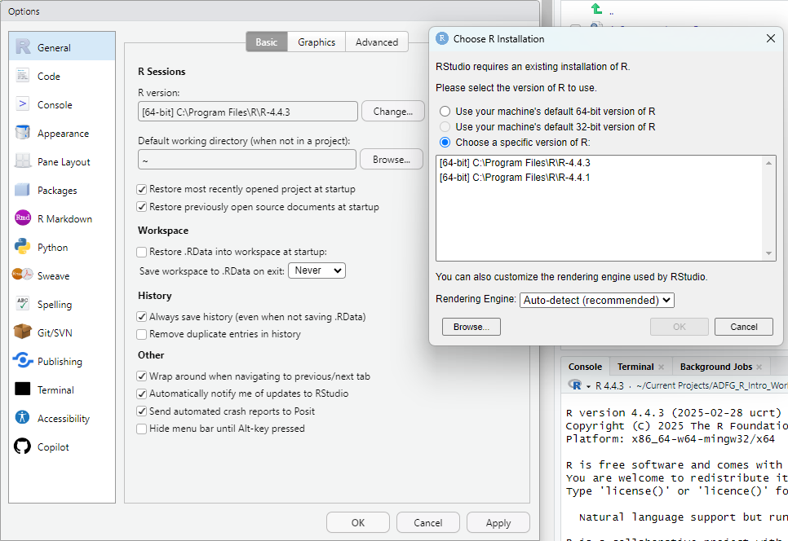
Possibly worth checking (particularly if you installed R once upon a time):
Did RStudio find the most recent version of R?
(4.4.3 as of today)
It may say “R Project” with no version number – this is probably not the most recent
Notes:
The other thing, which probably won’t be relevant to you, but it messed some things up for about 10% of the group the last time we did this class
Basically RStudio looks for the most recent version of R, and didn’t know what to do with “R Project” with no version number

Slide 10
RStudio cont.
Back to RStudio!
Let’s make those changes
We’ll also go over:
Advantages of RStudio projects
How to open a script
Highlighting a word
Changing the theme
Using the help tab

Slide 11




So wait, what does an RStudio Project actually do?
“Makes it straightforward to divide your work in contexts” – from the Posit website
Each work project can (and probably should) have an RStudio Project
Remembers which script files are left open (including unsaved ones, somehow)
Automatically sets working directory for data import & export
This is a bigger deal than it sounds like! Much easier to
Share a project with a collaborator
Move a project to another (computer) location
-> Share/move the associated folder
Notes:
So far we’ve just said that RStudio Projects are great and wonderful and you should use them … but we haven’t actually said what they are.
Basically, they make it easy to switch between projects and then everything kinda stays like you left it. It’s like you open a drawer, and there’s all the things you need.
--
Projects really just do two very simple things:
--
They remember which script files were open (which includes unsaved ones, somehow, but don’t rely on this)
They automatically set the working directory to the project directory
--
The second point sounds simple but it’s actually huge – and Logan is going to go into much more detail.
The basic version is that when you start working with real DATA (which is why you’re here!!) you will need to tell R where to find it, which used to be INCREDIBLY PAINFUL if you ever transferred a work project to a different drive or different computer.
--
With Projects, a folder can be a self-contained box that you can hand off or move around, and connections will work

Slide 12

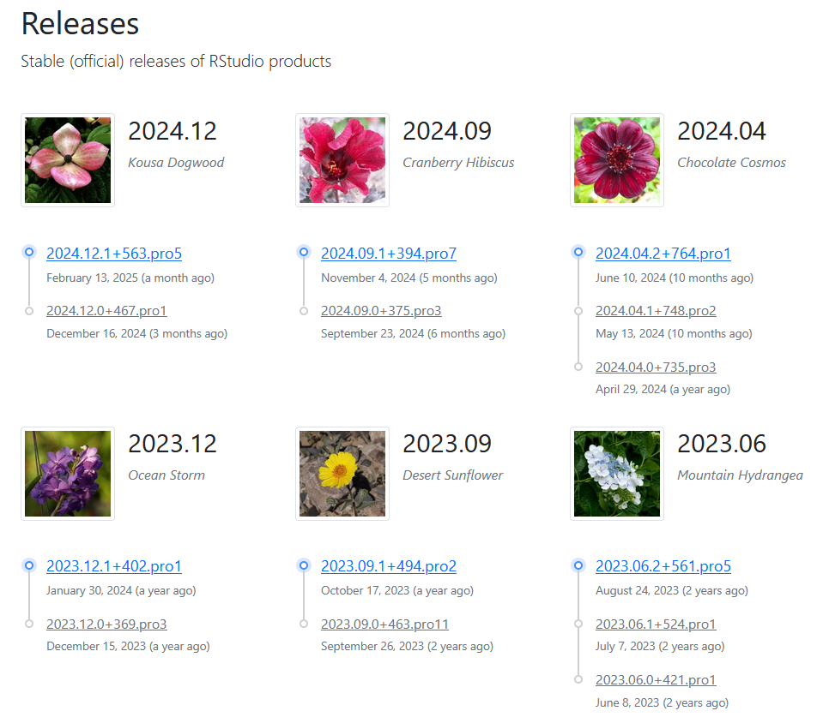
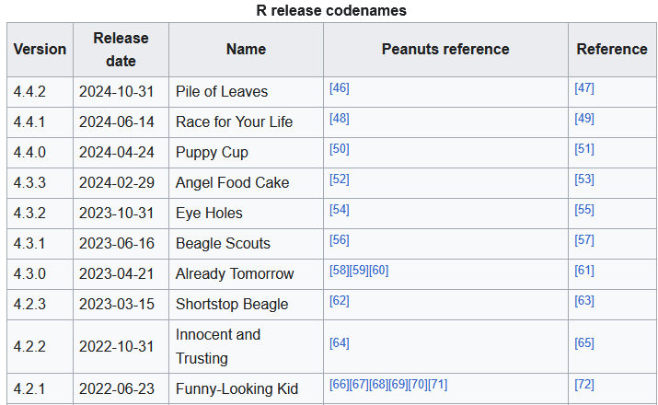
A note on Versions…
There are different “versions” of R, RStudio, and R packages
My (Matt’s) advice:
Don’t worry about this too much, generally a slightly old version will be just fine
I generally update R & RStudio when RStudio complains on startup (~3x/year)
Re-install both from the Software Center
You might need to reinstall packages that you’ve downloaded, but that’s probably fine
Can call update.packages() in R to update ALL external packages (you don’t have to do this, but this is how)
Notes:
And one more housekeeping note: like all software, R and RStudio have versions (so do all R packages) and you’ve probably noticed this
--
--
Generally, a somewhat recent version will work just fine (it worked earlier this year, it probably won’t break today)
I generally wait for RStudio to complain about the version and then I just reinstall from the Software Center
--
And a useless bit of trivia: RStudio versions are named after flowers
And R versions are named after Peanuts references

Slide 13
Quiz 2-1
When should you open the program “R” instead of RStudio?
a) Never. We always use RStudio.
b) Always. Kick it old school R
c) Always. I am a crusty old biometrician.
What are some advantages of using R projects?
a) Future advantages we haven’t covered yet.
b) Opens most recent scripts
c) Sets folder directory automatically
QUIZ!

Slide 14

Quiz 2-1 ANSWERS
When should you open the program “R” instead of RStudio?
a) Never. We always use RStudio.
b) Always. Kick it old school R
c) Always. I am a crusty old biometrician.
What are some advantages of using R projects?
a) Future advantages we haven’t covered yet.
b) Opens most recent scripts
c) Sets folder directory automatically
QUIZ!

Slide 15
Jargon
Function A set of commands that evaluates your data in a specific way. You can write your own functions, or they can be provided via other packages or from “Base R“.
Argument In a function, this is a possible input. For example: mean(data, na.rm = TRUE) uses an argument to remove NAs
Package A group of new commands / functions to extend the functionality of Base R.
Variable Something saved in R’s memory for use later.
Notes:
We’re going to throw some necessary jargon at you, and THESE TERMS WILL BE DEFINED LATER when we’re using them. But this way, hopefully you’re primed!

Slide 16
Jargon cont.
Dataframe A group of rows and columns (like a spreadsheet). Each column has a specific type (TRUE/FALSE, integer, number, character, factor, etc.).
Factor A type of variable that is a categorical grouping (“red” vs “blue”; “Treatment1” vs “Treatment2” vs “Treatment3”).
<- The “leftward arrow” assigns the information on the right to the variable on the left. For example: x1 <- 42
c() Lowercase c means concatenate which groups a bunch of things together. For example: x1 <- c(“duck”, “duck”, “duck”, “goose!”)
Notes:
We can use the rightward arrow too but this is less common

Slide 17
Some special characters
[ ] Square brackets mean selecting a subset
== To check if things are equal, use two equals signs together
!= To check if things are NOT equal, use this
<, <=, >, >= Less than (or equal to), greater than (or equal to)
&, |, !, %in% And, or, not, is contained in
~ In base R the tilde usually means “as a function of…”
(in the context of plotting or regression)

Slide 18
More special characters
$ Selects a particular column of a dataframe, or something else with a name For example: dataframename$column1
# Makes a “comment” (not run code), telling R to not run anything on this line to the right
> print(“Hello!”) #This line only evaluates the Hello! part ignoring this
Also: Lines must end with a comma, bracket, or similar. If you want your code to continue to the next line, you will need a comma at the end of a line
Notes:
Removed these two:
rm() Removes a variable from your workspace
str() Inspects the structure of a variable

Slide 19
Let’s head to RStudio
Let’s familiarize ourselves with RStudio
You are learning two things at once: the new-to-you program RStudio and the R language
We’ll put what we just learned to use in RStudio and review the basics of the program. You can watch my screen and write the code yourselves too.
Later, revisit the script on your own. Consider modifying lines
Read the comments then run the line (“Run” or Ctrl+Enter)
Go slow, it isn’t a race
Ask yourself why something works or fails

Slide 20
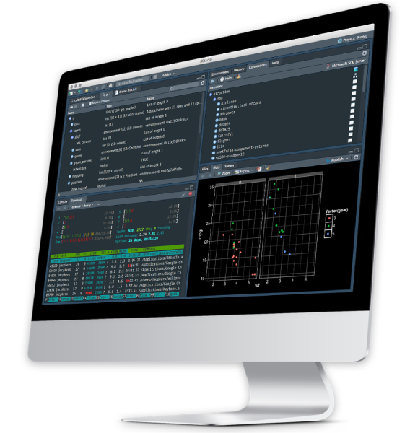
One last RStudio tip
If you’d like, you can change the appearance of RStudio (color & theme)
Go to Tools -> Global Options -> Appearance
Choose an “Editor Theme” that you like

Slide 21
RStudio Summary
What we have learned
How to open a RStudio project
4 panes in RStudio
How to run a line
Difference between script & console
Autocomplete for functions & variables
Highlighting a word
Help!

Slide 22
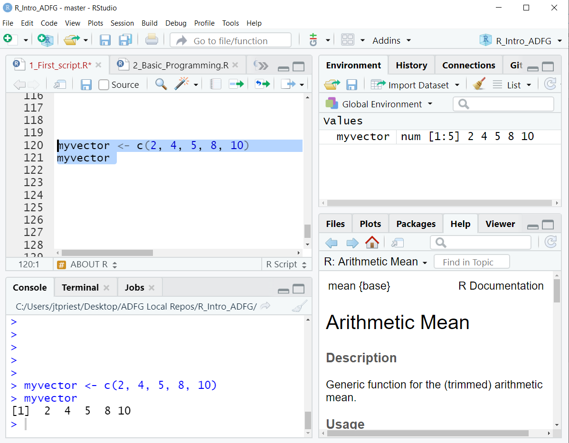
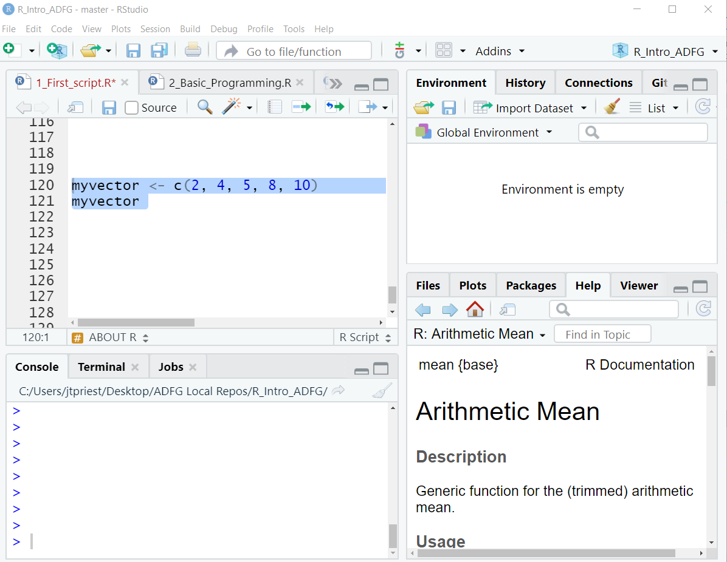
RStudio Review
Use “<-” to store something
Ctrl + Enter (or Run Button) evaluates the line of code (sending it to console)
Put cursor somewhere in that line, or highlight the chunk you want
Objects in the environment disappear once we close R. We’ll need to re-run whole script to get them back. They don’t “live” anywhere permanently.

Slide 23
Quiz 2-2
Which symbols would we use to “set something equal to” and “make a comment / don’t run line”?
a) == and comment()
b) <- and #
c) equal and c()
d) $$ and RUN
How can we tell R to run (evaluate) a line of code?
a) Ask nicely
b) Ctrl + Enter
c) Swear
d) “Run” button
QUIZ!

Slide 24
Quiz 2-2 ANSWERS
Which symbols would we use to “set something equal to” and “make a comment / don’t run line”?
a) == and comment()
b) <- and #
c) equal and c()
d) $$ and RUN
How can we tell R to run (evaluate) a line of code?
a) Ask nicely
b) Ctrl + Enter
c) Swear
d) “Run” button
QUIZ!
Why?
Leftward arrow sets something while the hashtag means don’t run this line
Why?
There are two ways to run a line;
I usually use the keyboard shortcut

Slide 25
Quiz 2-3
How do we “store” a variable to access it later?
a) <-
Chant “variahble returno”
save()
store()
Which pane is the editor (1), and which is the console (2)?
QUIZ!
a)
b)
c)
d)

Slide 26
Quiz 2-3 ANSWERS
How do we “store” a variable to access it later?
a) <-
Chant “variahble returno”
save()
store()
Which pane is the editor (1), and which is the console (2)?
QUIZ!
(1a)editor
(2c)console

